Slide 1
Graph Theory
Euler

Slide 2
Euler’s Theorem
A path on a graph can be traced if
It is connected (every vertex is connected by some number of edges)
It has either no odd vertices or two odd vertices
If a graph has two odd vertices, the tracing must begin at one of these and end at the other. If all the vertices are even then the graph must begin and end at the same vertex. It does not matter at which vertex this occurs.

Slide 3
Definitions
Path : series of connected edges in which no edge is repeated.
Length: number of edges in a path.
Valence: The number of edges touching that vertex (like counting the spokes on a bicycle wheel).

Slide 4
More Definitions
Euler Path: a path containing all edges of the graph.
Euler circuit: an Euler path that ends and begins at the same vertex.
Eulerian graph: a graph with all even vertices and contains an Euler circuit.

Slide 5
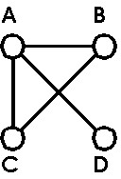
An Euler Circuit
Find some paths in this graph
Find an Euler path in this graph
Is their an Euler circuit?

Slide 6
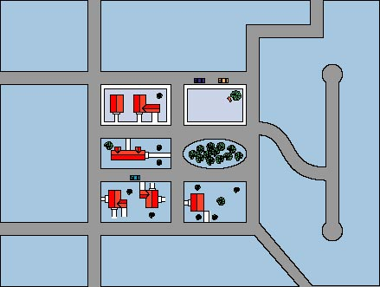
Euler Circuits
Parking-Control Officer Problem
Checking parking meters
Our job is to find the most efficient route for the parking-control officer to walk as he checks the parking meters.
Problem: Check the meters on the top two blocks.
Goals for Parking-Control Officer
Must cover all the sidewalks without retracing any more steps than necessary.
Should end at the same point at which he began.
Problem: Start and end at the top left-hand corner of the left-hand block.
Street map for part of a town.
Euler circuit – A circuit that traverses each edge of a graph exactly once and starts and stops at the same point.
6

Slide 7
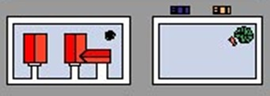

Slide 8
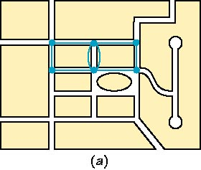
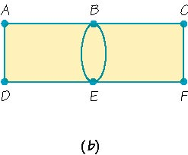
Euler Circuits
Simplified graph (b) is enlarged to show
the points (vertices) labeled with letters A – F which are linked by edges.
Simplified graph (a) is superimposed on the streets with parking meters.
Graph – A finite set of dots (vertices) and connecting links (edges).
Graphs can represent our city map, air routes, etc.
Vertex (pl. vertices) – A point (dot) in a graph where the edges meet.
Edge – A link that joins two vertices in a graph (traverse edges).
Path – A connected sequence of edges showing a route, described
by naming the vertices traveled.
Circuit – A path that starts and ends at the same vertex.
8

Slide 9
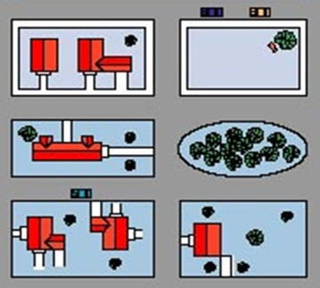

Slide 10
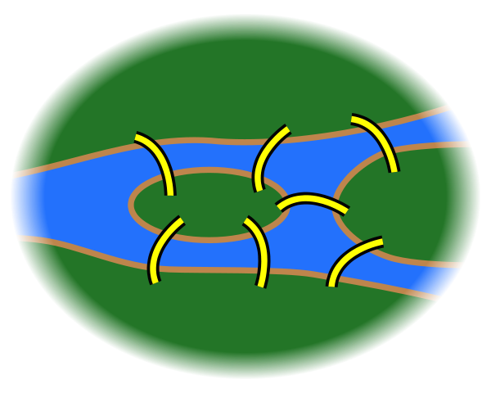

Slide 11
Fleury’s Algorithm
If a graph is connected and has all even vertices, we can find an Euler circuit as follows: Begin at any vertex and travel over consecutive edges according to the following rules:
After you have traveled over an edge, bold it. If all the edges of a particular vertex have been bolded, bold the vertex also.
Travel over an edge that is a bridge (an edge such that if it were removed the graph would no longer be connected) only if there is no alternative.

Slide 12
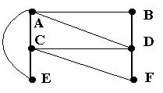
Example – Using Fleury’s Algorithm
Assume we are doing maintenance work joining locations A, B, C, … in a theme park. We want to find a Euler circuit to make our job efficient. Assume we start and end at C.

Slide 13
Example – Using Fleury’s

Slide 14
Final circuit - CDBAECADFC

