Slide 1
Markov Chains
Lesson 2

Slide 4
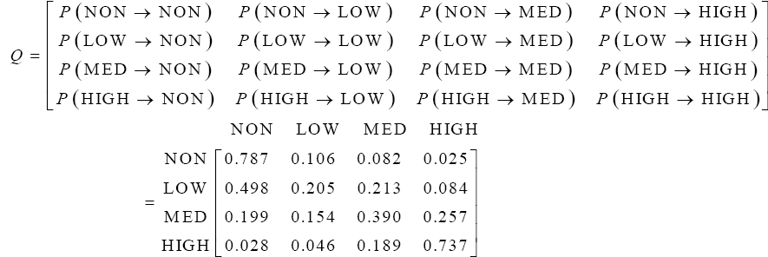

Slide 7
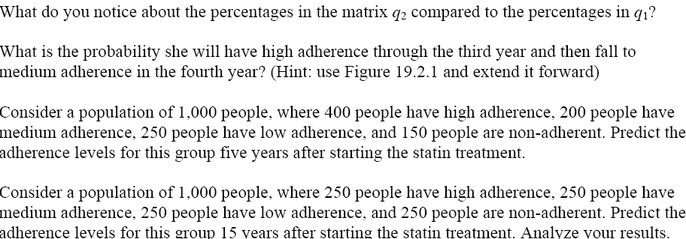

Slide 9
