Slide 1
Review Question
Find the winner based on Borda Count.

Slide 2
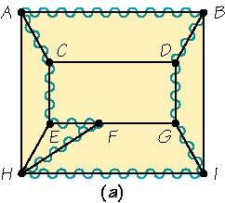
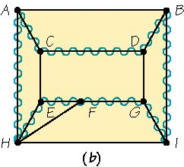
Chapter 2: Business Efficiency Hamiltonian Circuit
Hamiltonian Circuit
A tour that starts and ends at the same vertex (circuit definition).
Visits each vertex once. (Vertices cannot be reused or revisited.)
Circuits can start at any location.
Use wiggly edges to show the circuit.
Starting at vertex A, the tour can be written as ABDGIHFECA, or starting at E, it would be EFHIGDBACE.
A different circuit visiting each vertex once and only once would be CDBIGFEHAC (starting at vertex C).
2

Slide 3
Chapter 2: Business Efficiency Hamiltonian Circuit vs. Euler Circuits
Hamiltonian vs. Euler Circuits
Similarities
Both forbid re-use.
Hamiltonian do not reuse vertices.
Euler do not reuse edges.
Differences
Hamiltonian is a circuit of vertices.
Euler is a circuit of edges.
Euler graphs are easy to spot (connectedness and even valence).
Hamiltonian circuits are NOT as easy to determine upon inspection.
Some certain family of graphs can be known to have or not have Hamiltonian circuits.
Hamiltonian circuit – A tour (showed by wiggly edges) that starts at a vertex of a graph and visits each vertex once and only once, returning to where it started.
Euler circuit – A circuit that traverses each edge of a graph exactly once and starts and stops at the same point.
3

Slide 4
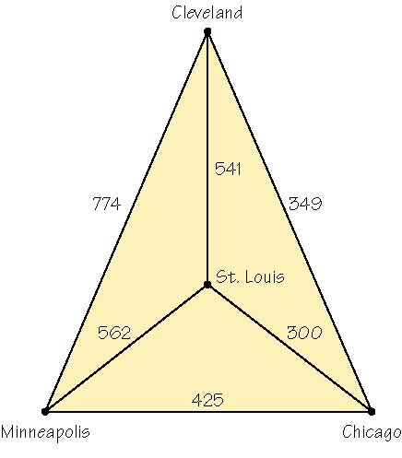
Chapter 2: Business Efficiency Hamiltonian Circuits
Vacation–Planning Problem
Hamiltonian circuit concept is used to find the best route that minimizes the total distance traveled to visit friends in different cities. (assume less mileage → less gas → minimizes costs)
Hamiltonian circuit with weighted edges
Edges of the graph are given weights, or in this case mileage or distance between cities.
As you travel from vertex to vertex, add the numbers (mileage in this case).
Each Hamiltonian circuit will produce a particular sum.
Road mileage between four cities
4

Slide 6
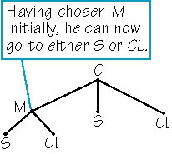
Chapter 2: Business Efficiency Hamiltonian Circuit
Minimum-Cost Hamiltonian Circuit
A Hamiltonian circuit with the lowest possible sum of the weights of its edges.
Algorithm (step-by-step process) for Solving This Problem
Generate all possible Hamiltonian tours (starting with Chicago).
Add up the distances on the edges of each tour.
Choose the tour of minimum distance.
Algorithm – A step-by-step description of how to solve a problem.
6

Slide 7
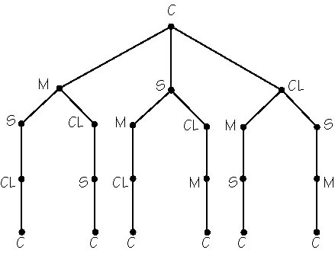
Chapter 2: Business Efficiency Hamiltonian Circuits
Method of Trees
For the first step of the algorithm, a systematic approach is needed to generate all possible Hamiltonian tours (disregard distances during this step).
This method begins by selecting a starting vertex, say Chicago, and making a tree-diagram showing the next possible locations.
At each stage down, there will be one less choice (3, 2, then 1 choice).
In this example, the method of trees generated six different paths, all starting and ending with Chicago.
However, only three are unique circuits.
Method of trees for vacation-planning problem
7

Slide 8
Chapter 2: Business Efficiency Hamiltonian Circuit
Principle of Counting for Hamiltonian Circuits
For a complete graph of n vertices, there are (n - 1)! possible routes.
Half of these routes are repeats, the result is:
Possible unique Hamiltonian circuits are
(n - 1)! / 2
Complete graph – A graph in which every pair of vertices is joined by an edge.
Fundamental Principle of Counting
If there are a ways of choosing one thing,
b ways of choosing a second after the first is chosen,
c ways of choosing a third after the second is chosen…, and so on…,
and z ways of choosing the last item after the earlier choices,
then the total number of choice patterns is a × b × c × … × z.
Example: Jack has 9 shirts and 4 pairs of pants. He can wear 9 × 4 = 36 shirt-pant outfits.
8

Slide 9
Chapter 2: Business Efficiency Traveling Salesman Problem
Traveling Salesman Problem (TSP)
It’s difficult to solve Hamiltonian circuits when the number of vertices in a complete graph increases (n becomes very large).
This problem originated from a salesman determining his trip that minimizes costs (less mileage) as he visits the cities in a sales territory, starting and ending the trip in the same city.
Many applications today: bus schedules, mail drop-offs, parking meter coin pick-up routes, etc.
How can the TSP be solved?
Computer program can find optimal route (not always practical).
Heuristic methods can be used to find a “fast” answer, but does not guarantee that it is always the optimal answer.
Nearest neighbor algorithm
Sorted edges algorithm
9

Slide 10
600
700
500
950
650
750
550
850
400
800

Slide 11
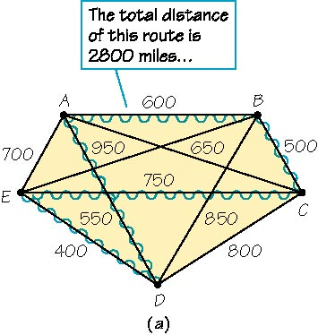
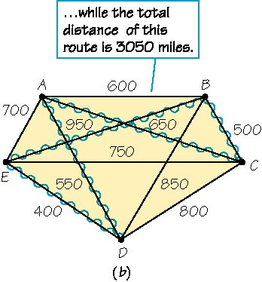
Chapter 2: Business Efficiency Traveling Salesman Problem — Nearest Neighbor
Nearest Neighbor Algorithm (to solve TSP)
Starting from the “home” city (or vertex), first visit the nearest city (one with the least mileage from “home”).
As you travel from city to city, always choose the next city (vertex) that can be reached quickest (i.e., nearest with the least miles), that has not already been visited.
When all other vertices have been visited, the tour returns home.
Hamiltonian Circuit: A-B-C-E-D-A
Hamiltonian Circuit: B-C-A-D-E-B
Nearest neighbor starting at vertex A
Nearest neighbor starting at vertex B
11

Slide 12
Chapter 2: Business Efficiency Traveling Salesman Problem — Sorted Edges
Sorted Edges Algorithm (to solve TSP)
Start by sorting, or arranging, the edges in order of increasing cost (sort smallest to largest mileage between cities).
At each stage, select that edge of least cost until all the edges are connected at the end while following these rules:
If an edge is added that results in three edges meeting at a vertex, eliminate the longest edge.
Always include all vertices in the finished circuit.
Example using sorted edges Edges selected are DE at 400, BC at 500, AD at 550, and AB at 600 (AC and AE are not chosen because they result in three edges meeting at A). Lastly, CE at 750 is chosen to complete the circuit of 2800 miles.
12

Slide 13
 | Jacksonville, FL | Atlanta, GA | Charlotte, NC | Columbia, SC | Auburn, AL
Jacksonville, FL | 0 | 345.8 | 383.5 | 288.6 | 326.3
Atlanta, GA | 345.8 | 0 | 244.8 | 214.0 | 108.1
Charlotte, NC | 383.5 | 244.8 | 0 | 92.8 | 351.3
Columbia, SC | 288.6 | 214.0 | 92.8 | 0 | 317.3
Auburn, AL | 326.3 | 108.1 | 351.3 | 317.3 | 0

Slide 14
