Slide 1
Markov Chains
More with Matrices

Slide 4
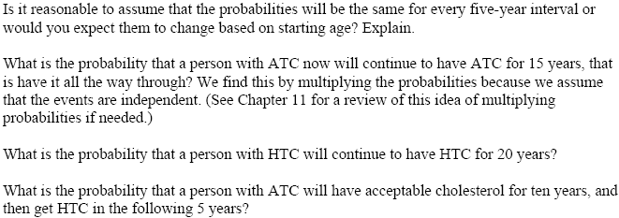

Slide 5
Markov Chains
We are using the discrete Markov chain process
They have the Markov property
The future only depends on the present state and is independent
This is also called memorylessness
They are also stochastic
All transitions are probabilistic

Slide 7
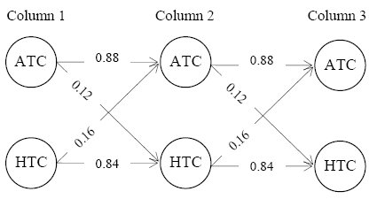

Slide 8
